Slide 1
Supplements, But Make Them Chocolate.

Slide 2
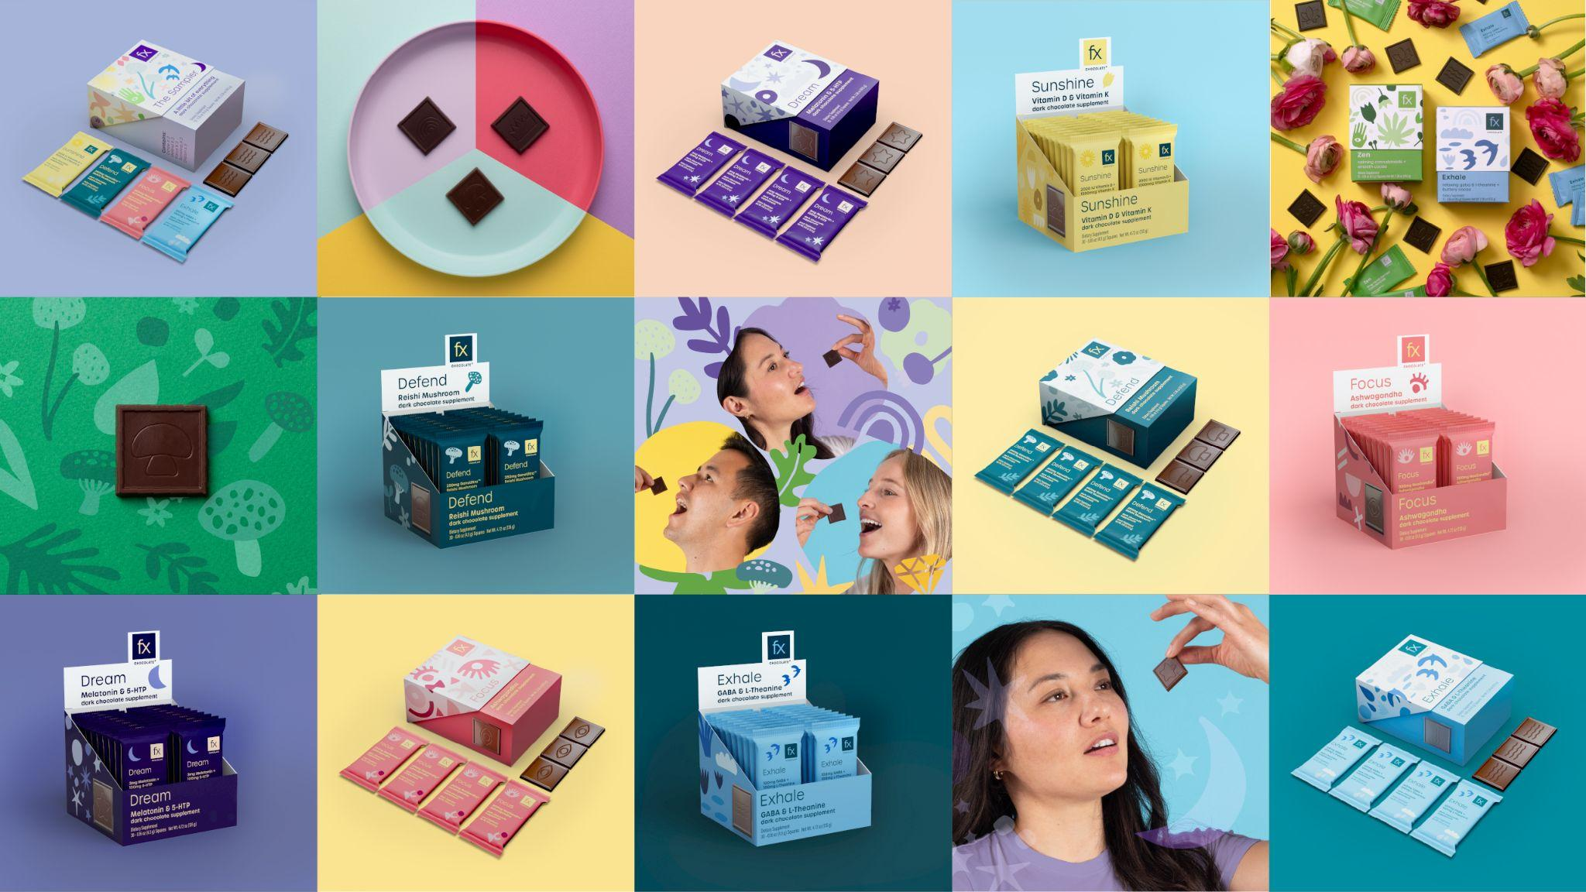

Slide 3
Our Vision and History
FX Chocolate is the first new brand from 30 year practitioner supplement industry leader Designs for Health. Our formulas are backed by research, best in class raw materials and a Certificate of Analysis for every batch.
Enjoying one’s daily health ritual is the future of how your patients interact with their supplements. Supplement chocolate that is sugar free and truly artisanal is a new, fresh approach to this.

Slide 4
Our Mission
We believe the best supplement is the one you actually take. By infusing clinically relevant doses of active ingredients into world class, sugar free chocolate we make the daily ritual of wellness instantly rewarding.
Sourcing only the absolute best ingredients and third-party testing all of our products, we are the gold standard of a new era of integrative wellness where the choice to put health first is the same as putting enjoyment first.

Slide 5
Fx Chocolate: A New Idea Done Right.
At Fx Chocolate we saw an opportunity to fill a space in the market for a chocolate + supplement delivery system with no sugar or dairy at a therapeutic dose.
Up to 300mg of active per square = meaningful doses of active ingredients of the highest quality
Zero sugar and no impact on blood sugar nor GI upset by using Allulose
Chocolate delivery system can improve bioavailability of active ingredient
Cost in line with other solid dosage forms

Slide 6
Why FX Chocolate?
Supplements, but make them chocolate.
Sweet Supplements
Dietary supplements delivered in delicious chocolate.
Pill Fatigue
Chocolate improves consumer compliance.
Convenience
Easy to take on the go, single wrapped serving.
Permission to Indulge
No guilt, no sugar, keto friendly, and great taste.
Clean & Green
Minimal ingredients, bean to bar production,
product transparency.

Slide 7
Artisanal Chocolate with Functional Benefits - Our Key Product Developers
FX Chocolates are hand-made by our Award winning Head Chocolate maker Morgan Coleman
Morgan has turned the science of supplements and chocolate into a supremely delicious artform. His attention to detail means every single Fx Chocolate is crafted with care and unwavering commitment.
Dr. David Brady (ND, DC, CCN, DACBN, IFMCP, FACN) has 28 years of experience as an integrative medicine practitioner, researcher and formulator
He and his team of scientists ensure Fx is backed by research every bit as good as our chocolate.

Slide 8
Chocolate is an Effective Delivery System
Cacao contains more phenolic compounds than most foods. Flavonoids, including catechins, epicatechins and procyanidins carry significant antioxidant activity.
The epicatechin content of cacao helps to upregulate nitric oxide production, leading to a vasodilation effect, increasing the body’s ability to uptake nutrients and herbs delivered.
The high lipid content of the cocoa butter in chocolate can assist in protecting active ingredients from degradation.
As lipids are the building blocks of cell membranes, active ingredients can have higher affinity towards cellular absorption when delivered in a high lipid based chocolate.

Slide 9
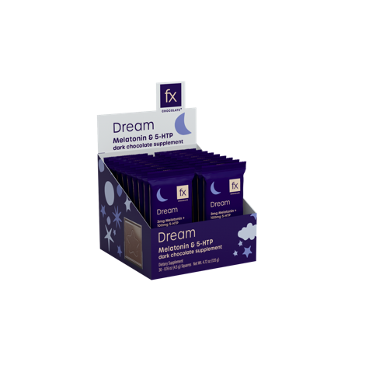
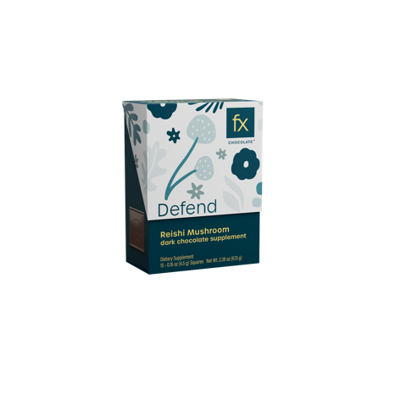
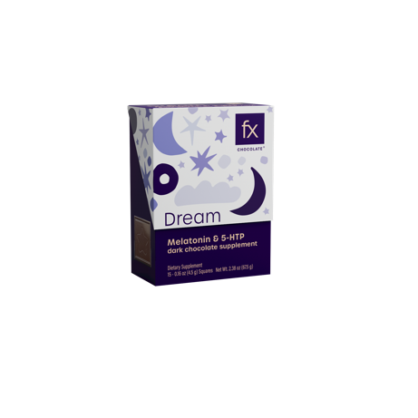
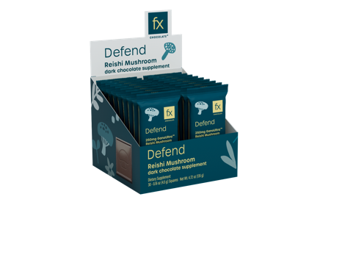
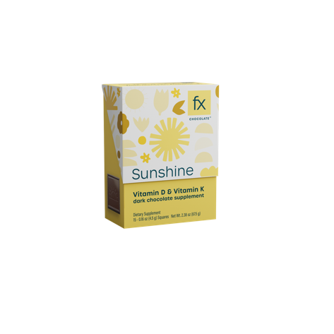
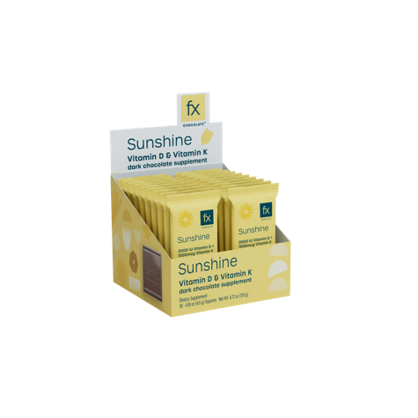
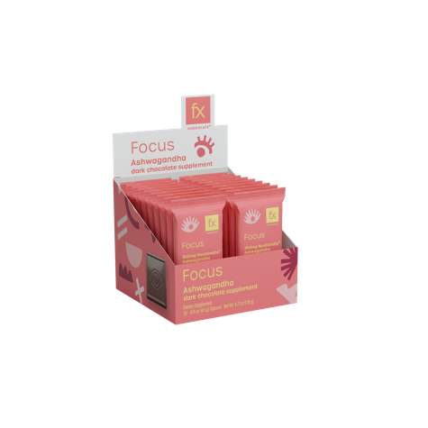
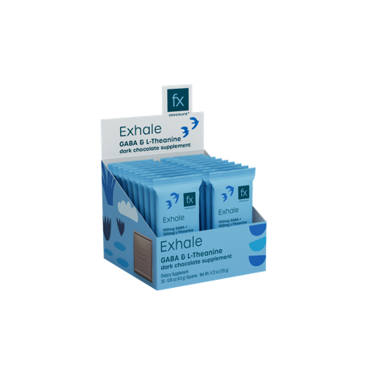
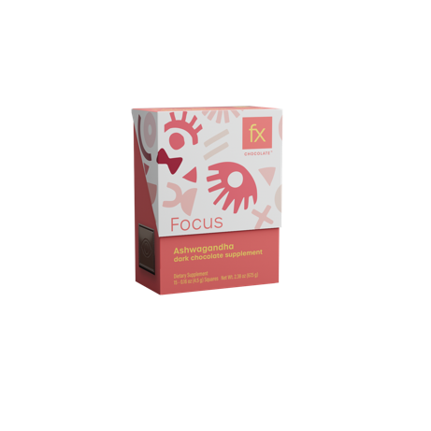
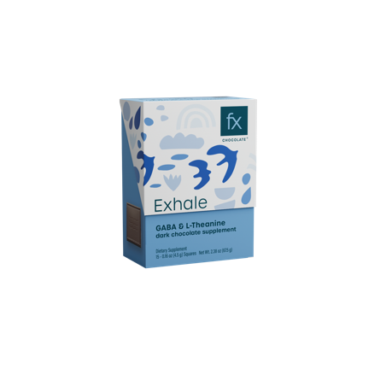
Product Lineup
15-count box
30-count box (converts to POS display for 1-count sales units)

Slide 10
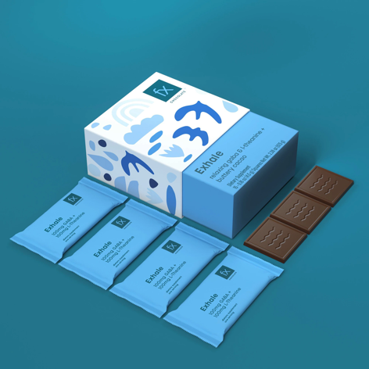
Benefits of Allulose
Allulose is a rare sugar found naturally in figs, raisins, jackfruit and maple syrup. Humans lack the enzymes to digest allulose, so it is largely excreted, but without the unpleasant GI effects associated with certain sugar alcohols. It is excreted primarily in the urine and has very low colonic microbial fermentability.
Allulose is an ideal sweetener for those on ketogenic or reduced carb diets, as it has no impact on blood glucose or insulin levels when consumed in reasonable amounts. The glycemic impact of allulose is zero, and research indicates that allulose contributes to a lowering of postprandial glucose and insulin with an increase in fat oxidation in humans.
The U.S. Food and Drug Administration (FDA) recognizes that while allulose has a chemical structure similar to other sugars, it is not metabolized by the body in the same way as most sugars and does not contribute the same number of calories. It has just one-tenth the calories of sucrose — only 0.4 calories per gram.

Slide 11
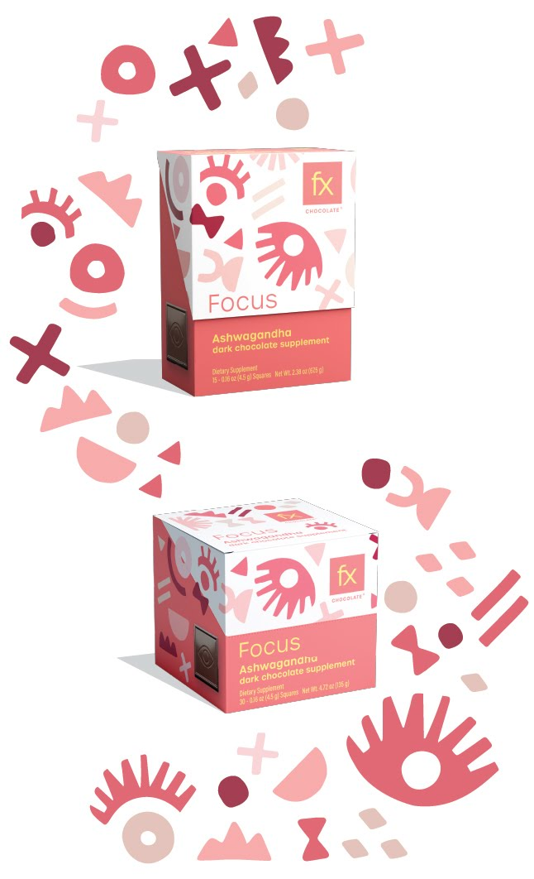
The Range – Focus
15 count box
MSRP | $20.00
UPC | 879452005662
Unit Size | 3.16 Oz.
Dims | 3”W x 1.56”L x 4.03125”H
NooGandha® is a next generation ashwagandha extract that works with our mind as a cognitive nootropic to help you focus.
Ashwagandha is an herb that has been used traditionally in times of stress to normalize the physiological process of the body and help the body adapt to change.
Fx Focus contains clinically trialed 300mg of NooGandha® extract per serving delivering both adaptogenic benefits and newly discovered compounds for nootropic cognitive support.
NooGandha® still retains ashwagandha’s powerful adaptogenic qualities but provides additional newly discovered compounds called Withanoid I and Withanoid II specifically chosen for their nootropic properties.
30 count box
MSRP | $34.99
UPC | 879452006362
Unit Size | 5.87 Oz.
Dims | 3.03”W x 2.91”L x 3.03”H
Single count
MSRP | $1.99
UPC | 879452006416
Ingredients: Cacao nibs, allulose, organic cocoa butter. Made on equipment shared with nuts and milk.

Slide 12
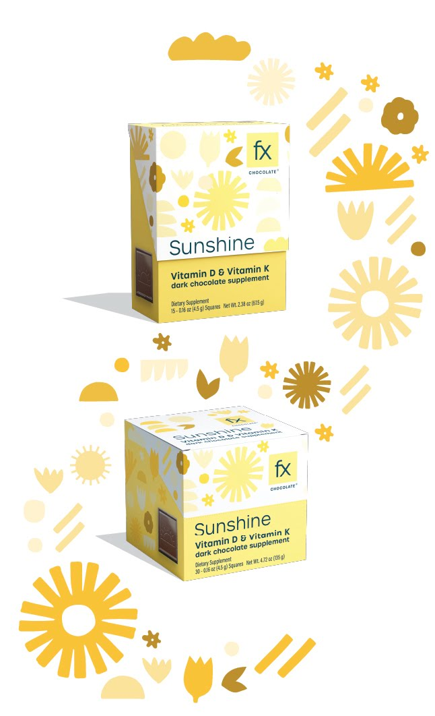
The Range – Sunshine
15 count box
MSRP | $20.00
UPC | 879452005792
Unit Size | 3.16 Oz.
Dims | 3”W x 1.56”L x 4.03125”H
Fx Chocolate® Sunshine is a synergistic blend of vitamin D3 and bioavailable forms of vitamin K infused in dark chocolate specifically designed to help promote bone health, immune function and heart health.
This formula combines 50 mcg (2,000 IU) of vitamin D3, 1 mg of vitamin K2 as MK4, and 500 mcg of vitamin K1 per serving.
Fx Sunshine may help balance the body’s calcium needs while promoting bone strength and supporting immune health.
Fx Sunshine may be beneficial for individuals who do not get adequate sunlight exposure and/or dietary sources of these important fat-soluble vitamins.*
30 count box
MSRP | $34.99
UPC | 879452006379
Unit Size | 5.87 Oz.
Dims | 3.03”W x 2.91”L x 3.03”H
Single count
MSRP | $1.99
UPC | 879452006423
Ingredients: Cacao nibs, allulose, organic cocoa butter. Made on equipment shared with nuts and milk.

Slide 13
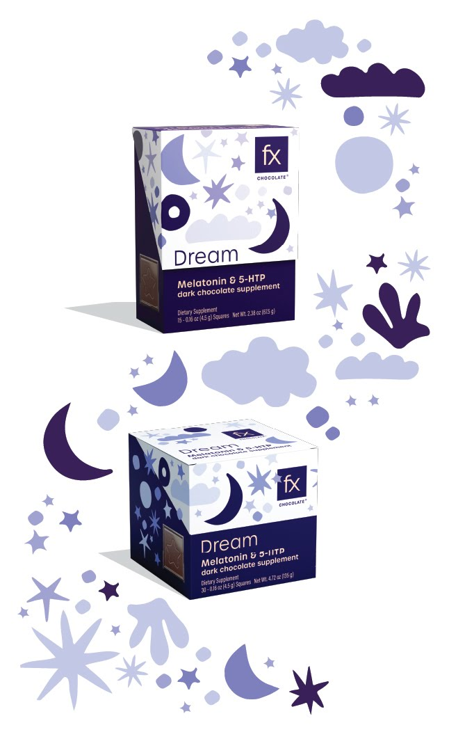
The Range – Dream
15 count box
MSRP | $20.00
UPC | 879452005808
Unit Size | 3.16 Oz.
Dims | 3”W x 1.56”L x 4.03125”H
Sea otters hold hands when they sleep so they don’t drift apart from each other. Find that kind of sweet comfort with our melatonin formula. Sometimes we need a little extra support to achieve our dreams.
Fx Dream contains a functional 3mg dose of Melatonin and 100mg 5-HTP per serving to promote the brain's ability to naturally relax and rest.
Melatonin is a multifunctional hormone involved in the circadian (day/night) biological rhythms
5-HTP (5-Hydroxytryptophan) is a precursor to serotonin and works alongside melatonin to support our body’s ability to regulate stress levels, maintain proper serotonin, support overall relaxation, and sustain healthy immunity.
30 count box
MSRP | $34.99
UPC | 879452006355
Unit Size | 5.87 Oz.
Dims | 3.03”W x 2.91”L x 3.03”H
Single count
MSRP | $1.99
UPC | 879452006393
Ingredients: Cacao nibs, allulose, organic cocoa butter. Made on equipment shared with nuts and milk.

Slide 14
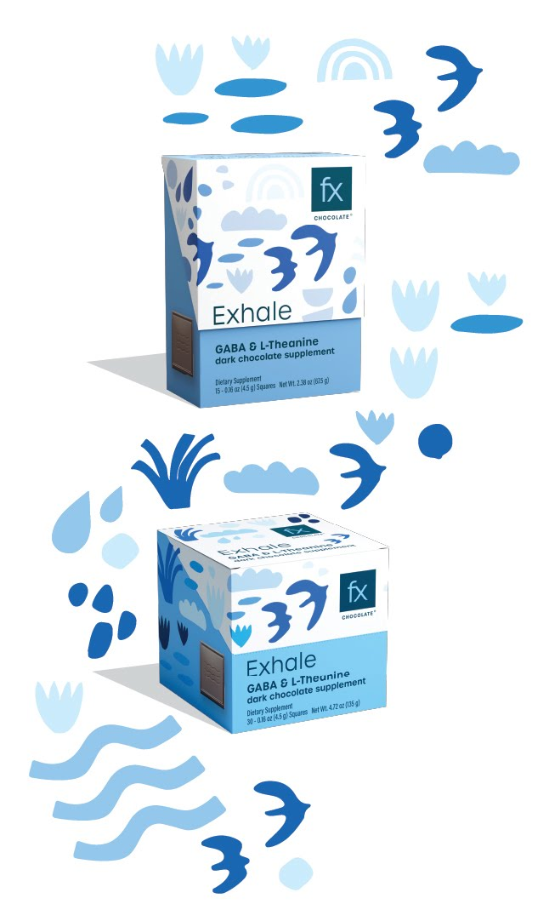
The Range – Exhale
15 count box
MSRP | $20.00
UPC | 879452005624
Unit Size | 3.16 Oz.
Dims | 3”W x 1.56”L x 4.03125”H
Exhale contains 100 mg of GABA and 100 mg of L-Theanine, both of which are well-regarded for promoting mental and emotional calm without impairing focus and attention.
GABA is a naturally occurring amino acid found in the brain. It works by slowing down the activity of nerve cells and preventing them from over-firing, helping to combat stress and occasional anxious feelings.
L-Theanine is an amino acid found mainly in tea (especially green tea) and various fungi. It’s known to promote a calm and a healthy response to stress. Because of this, L-theanine and GABA are a total dream team.
Neither GABA or L-theanine cause drowsiness.
30 count box
MSRP | $34.99
UPC | 879452006361
Unit Size | 5.87 Oz.
Dims | 3.03”W x 2.91”L x 3.03”H
Single count
MSRP | $1.99
UPC | 879452006409
Ingredients: Cacao nibs, allulose, organic cocoa butter. Made on equipment shared with nuts and milk.

Slide 15
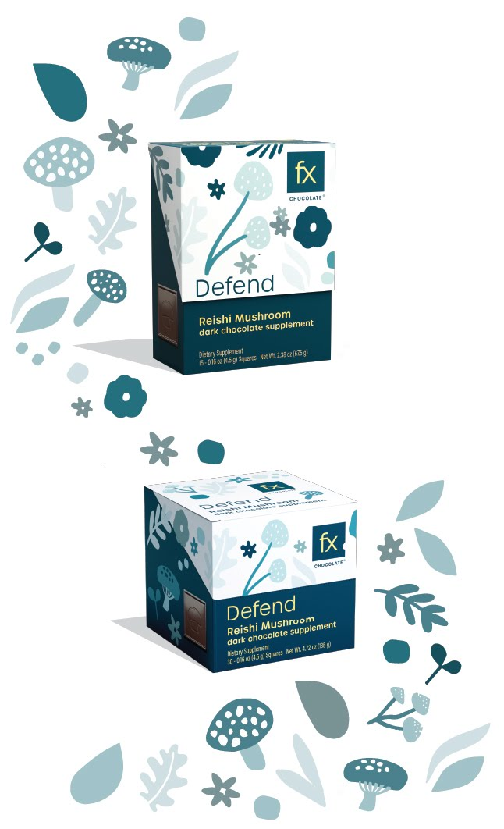
The Range – Defend
15 count box
MSRP | $20.00
UPC | 879452005648
Unit Size | 3.16 Oz.
Dims | 3”W x 1.56”L x 4.03125”H
Organic Reishi mushrooms are masters of immune support, energy, and cellular protection. Using every part of the mushroom enables maximum potency. Fx Defend contains 250 mg of GanoUltra (per serving): three individually extracted strains of full-spectrum reishi (Ganoderma lucidum, Ganoderma applanatum and Ganoderma tsugae).
Uses every part of the 100% organic mushrooms for maximum potency - mycelium, primordia, fruiting bodies and extracellular compounds - you receive all the benefits that the mushroom kingdom has to offer.
Fx Defend is packed with more than 150 mg of polysaccharides (60%) in every chocolate square to give you that slow and steady fire within.
30 count box
MSRP | $34.99
UPC | 879452006362
Unit Size | 5.87 Oz.
Dims | 3.03”W x 2.91”L x 3.03”H
Single count
MSRP | $1.99
UPC | 879452006386
Ingredients: Cacao nibs, allulose, organic cocoa butter. Made on equipment shared with nuts and milk.

Slide 16
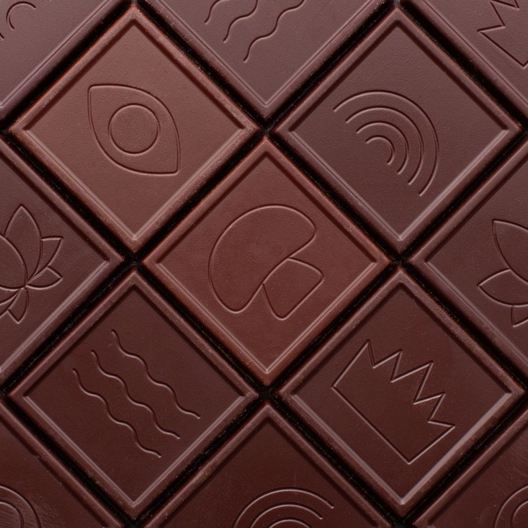
cGMP Quality Control
FX Chocolates are classified as dietary supplements and are quality controlled and assured in line with cGMP requirements.
Raw materials are validated and tested to ensure potency and within specifications.
Chocolate samples are taken in process and tested for potency, micro and heavy metals prior to tempering.
FX Chocolate finished goods are tested again to ensure label claims are met and products are within specification prior to being released for sale.
FX Chocolate shelf life is 18 months and ambient stability testing is conducted on all products.

Slide 17
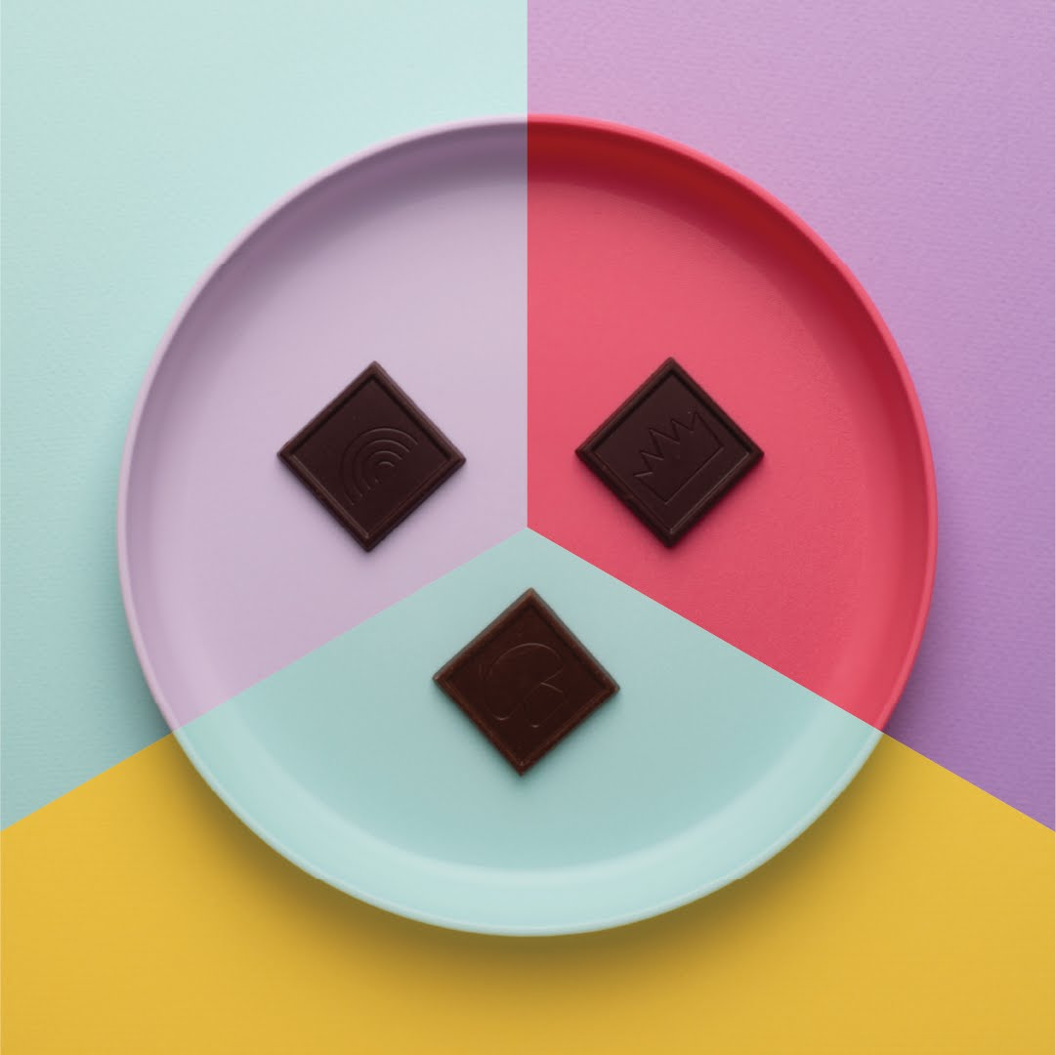
Transparency / Clean Formulation
Simple, clean formulation: Cacao nibs, allulose, organic cocoa butter.
Vegan, dairy free and gluten free, non-GMO.
Each product is labelled with a QR code where finished testing results can be viewed by batch code, to ensure confidence of label claim and product quality.

Slide 18
Let FX Boost Sales and Delight Patients
Unique Positioning
Fx Chocolate branding and packaging stands out in a clinic setting. Use Fx as a different way to offer your patients a solution that they can be excited about introducing into their health routines
Chocolate = Optimal Delivery System
Contains antioxidant boosting phenolic compounds, healthy lipids to protect and deliver active ingredients.
Compliance
With a therapeutic dose in every square you can be confident to include this on a subscription to add variety and alleviate the pill counting. Improve compliance = improved health outcomes
Easy to Sell
Condition specific formulas that deliver the benefits your patients are looking for. Easy to self select and understand. Suitable for front of store or prescription.

