Slide 1
A Breakthrough in diabetes care
Raz Itamar MD
Hebrew University Hadassah, Jerusalem, Israel
11/2021

Slide 2
Disclosures
Advisory Board: AstraZeneca, IMNA, Curalife
Consultant: AstraZeneca, BioPharma
Speaker’s Bureau: AstraZeneca, Eli Lilly and Company, Novo Nordisk

Slide 3
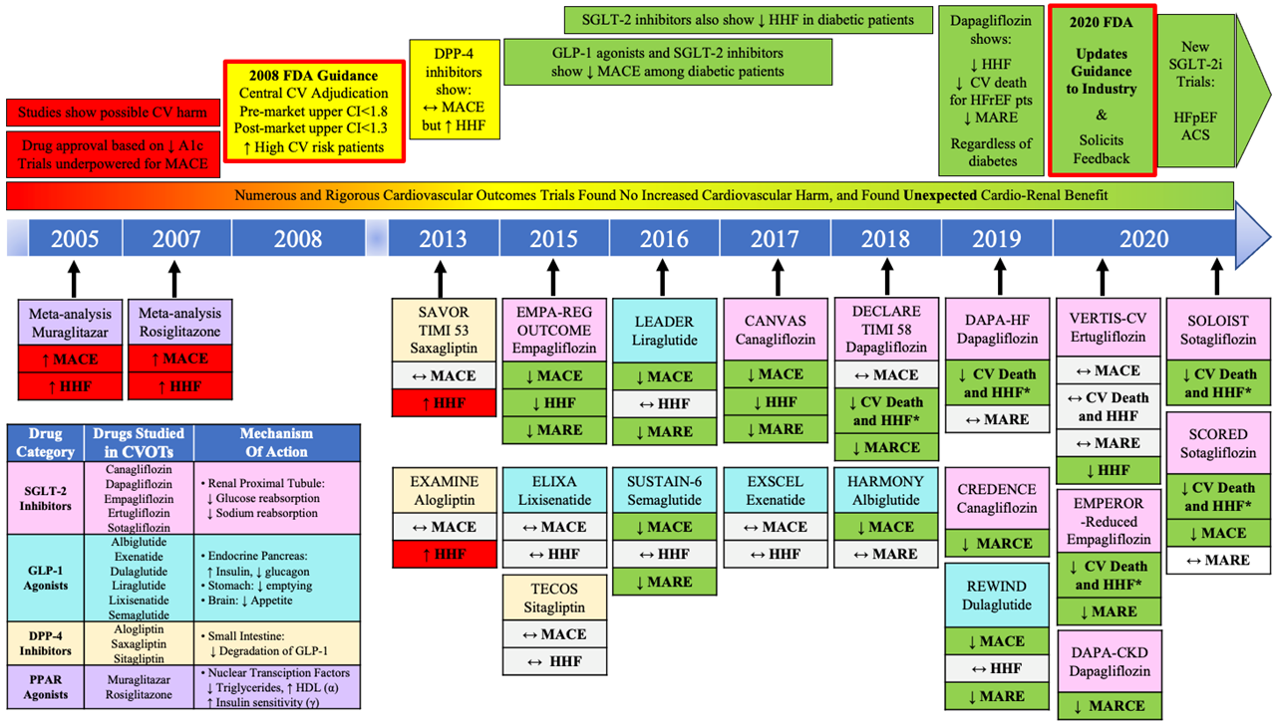
Noninsulin Diabetes Drug Development
Ferro EG, Elshazly MB, Bhatt DL. In press 2021.
Notes:
‹#›

Slide 4
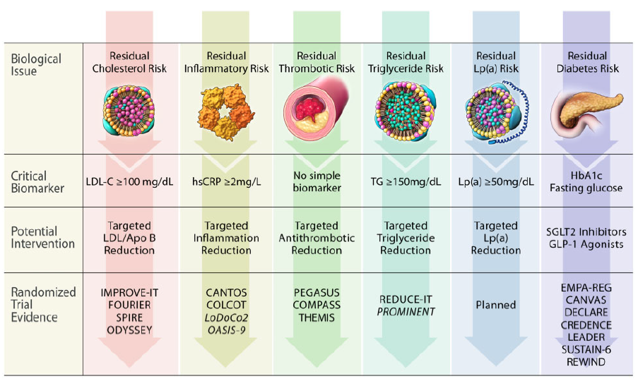
Redefining Residual Risk in the Current Era
Lawler PR, Libby P, Bhatt DL, Godoy LC, Luscher TF, Bonow RO, Verma S, Ridker PM. European Heart Journal 2020.
Notes:
‹#›

Slide 5
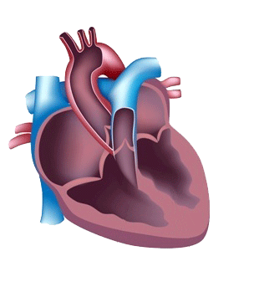
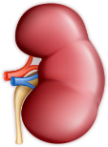
Type 2 diabetes, cardiovascular and renal disease are closely interconnected
T2D/Hyperglycemia
Glucose, AGEs, Lipids, BP, ROS, inflammation, fibrosis, RAAS, SNS
Acute or chronic disorder of one
can induce dysfunction in the other
Renal and cardiac systems are inextricably linked and should be considered together
AGEs = advanced glycation end-products; BP = blood pressure; RAAS = renin angiotensin aldosterone system; ROS = reactive oxygen species; SNS = sympathetic nervous system; T2D = type 2 diabetes. Maqbool M et al. Semin Nephrol 2018;38:217-232, 2. Ronco C et al. J Am Coll Cardiol. 2008;52:1527-39.
Notes:
Dapagliflozin: Primary Care Narrative
GLOBAL MEDICAL APPROVED DECK VEEVA ID: ML-1026-ALL-0101
Slide 14

Slide 6
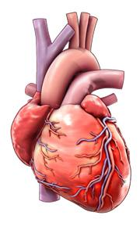
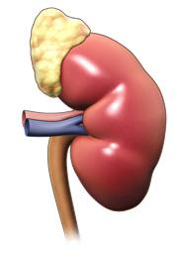
Diabetes
+
Na⁺-retention
Hypervolemia
RAAS Activation
Neurohumoral Activation
Inflammation
Ischemia
Altered Energetics
▬
SGLT2 Inhibitors
Connelly KA, Bhatt DL, Verma S. Cell Metabolism. 2018;28:813-815.

Slide 8
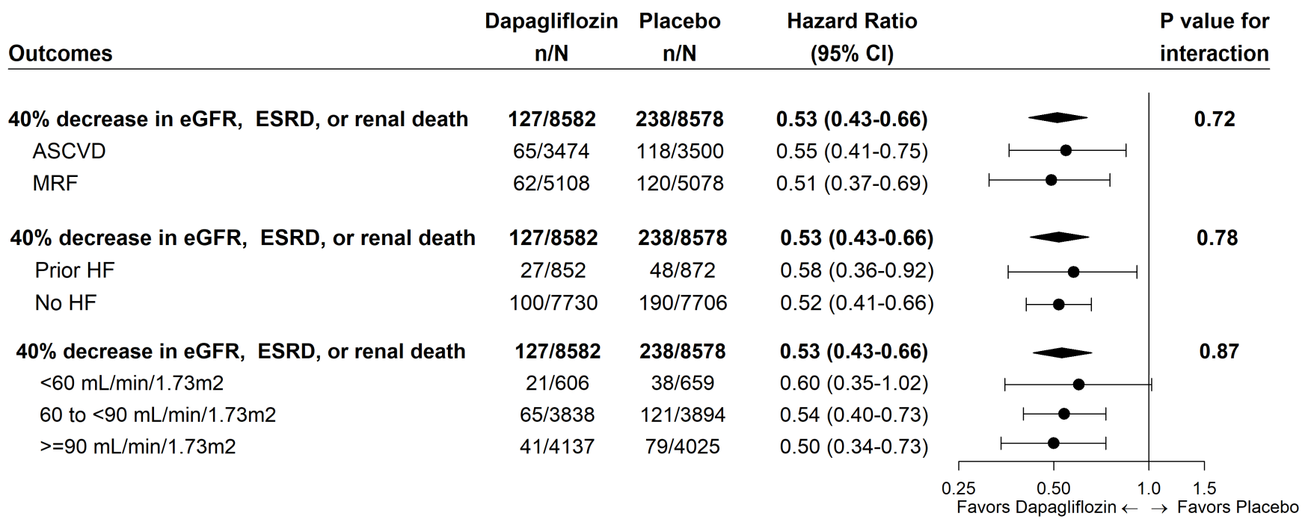
Subgroup Analysis of Renal Composite Outcome in DECLARE
~60% without established CVD
Wiviott SD, Raz I MD, et al. N Engl J Med. 2018 Nov 10. doi: 10.1056/NEJMoa1812389.

Slide 9
Summary
DAPA-CKD¹, the first dedicated renal outcomes trial to assess the efficacy and safety of an SGLT-2 inhibitor in patients with CKD with and without T2D, demonstrated:
39% RRR
for the primary composite endpoint (≥50% sustained decline in eGFR, ESKD, renal or CV death)
44% RRR
for the renal composite (≥50% sustained decline in eGFR, ESKD, or renal death)
29% RRR
for the composite of CV death or hospitalization for heart failure
31% RRR
all-cause mortality
CKD = chronic kidney disease; CV = cardiovascular; eGFR = estimated glomerular filtration rate; ESKD = end-stage kidney disease; HF = heart failure; hHF = hospitalization for heart failure; RRR = relative risk reduction; SGLT-2 = sodium glucose co-transporter 2; T2D = type 2 diabetes; UACR = urinary albumin-to-creatinine ratio.
1. Heerspink HJL. Presented at: ESC Congress – The Digital Experience; August 29 - September 1, 2020. 2. Wiviott SD. et al. N Engl J Med. 2019;380:347-357. 3. McMurray JJV et al. N Engl J Med. 2019;381:1995-2008.
Notes:
Present slide
References:
Heerspink HJL. Dapagliflozin in patients with chronic kidney disease [presentation]. Presented at: European Society of Cardiology Congress – The Digital Experience; August 29 - September 1, 2020.
Wiviott SD, Raz I, Bonaca MP, et al, for the DECLARE-TIMI 58 Investigators. Dapagliflozin and cardiovascular outcomes in type 2 diabetes. N Engl J Med. 2019;347-357.
McMurray JJV, Solomon SD, Inzucchi SE, et al, for the DAPA-HF Committees and Investigators. Dapagliflozin in patients with heart failure and reduced ejection fraction. N Engl J Med. 2019; 381:1995-2008.

Slide 10
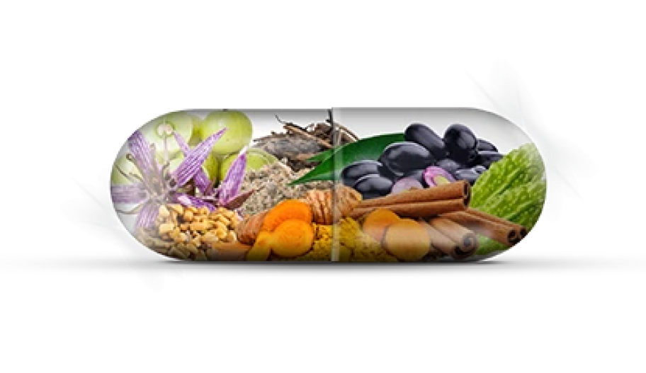

Slide 11
Pump, pipes and filter: Do SGLT2 inhibitors cover it all?
Cardiorenal efficacy of SGLT2i
Renal protection
Hospitalisation for heart failure
Major adverse cardiovascular events
Patients with HFrEF
With and without diabetes
Diabetes established cardiovascular disease
Patients with CKD
With and without diabetes
Diabetes and multipack risk factors
Patients with Type 1 Diabetes
Changes from Verma S, et al. Lancet 2018

Slide 12
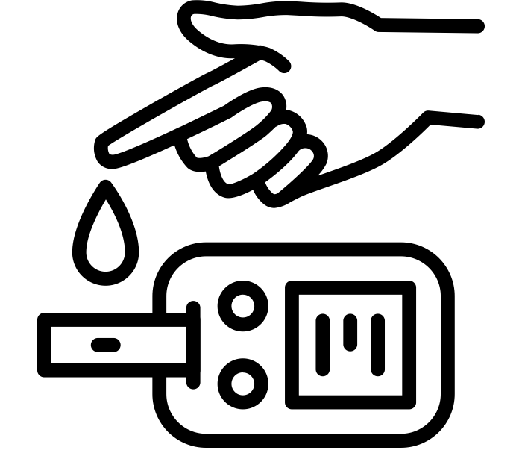
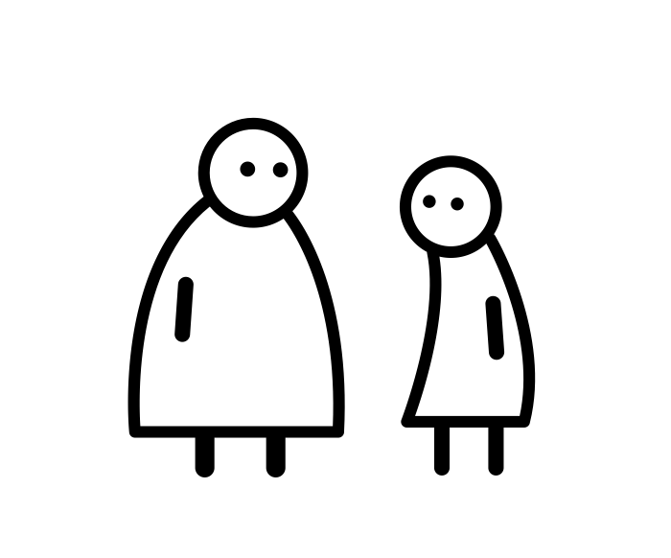
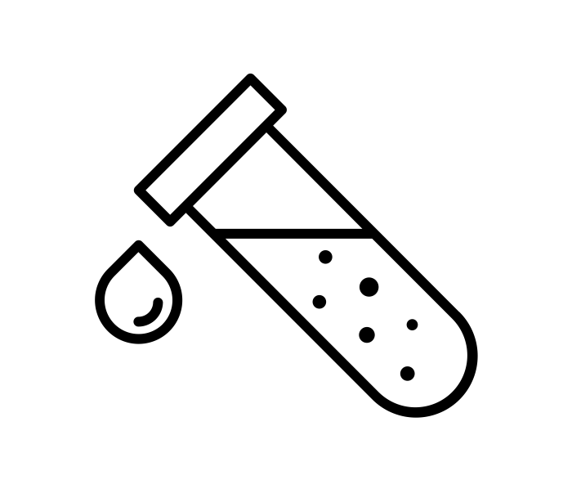
Effect of Metabolic parameters on Cardiorenal outcome
Glycemic control
Obesity
Lipids
Blood pressure

Slide 13
Association of HbA1c and CHD
N Engl J Med 2010;362:800-811.

Slide 14
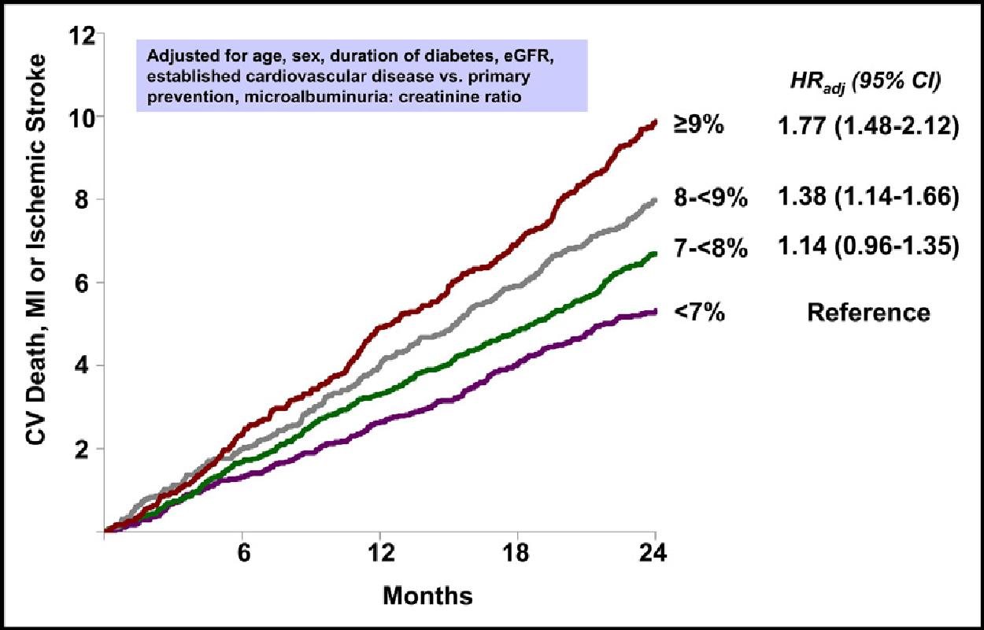
SAVOR-TIMI 53 Trial
Raz I et al: The American Journal of Medicine (2016) 129, 340.e1-340.e8

Slide 15
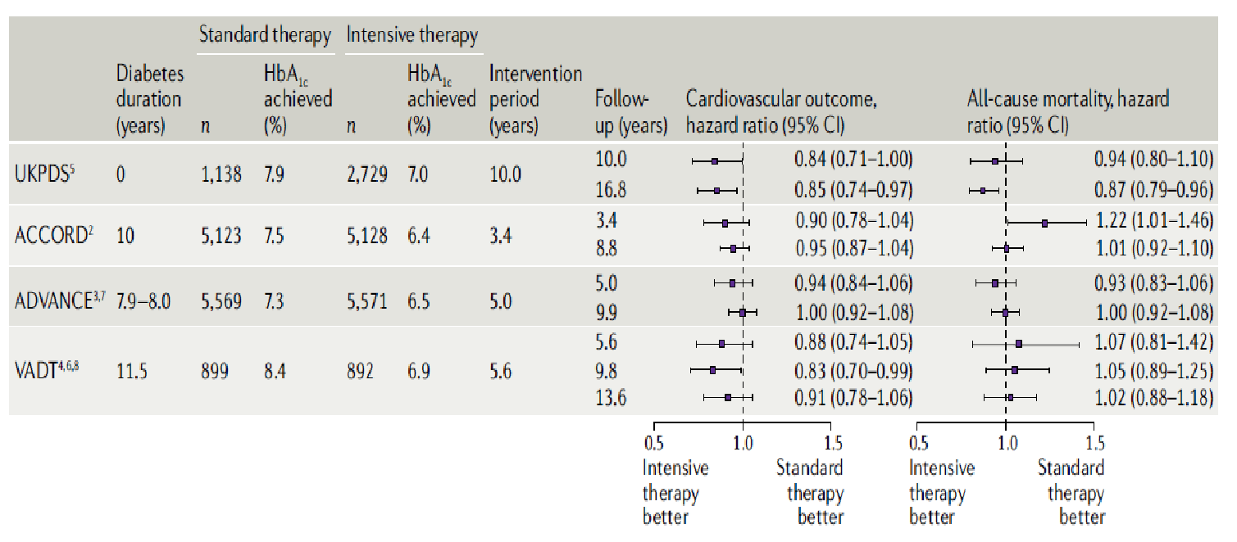
Optimal target of HbA1C in CV outcome studies
Nat Rev Cardiol 16, 517–518 (2019)

Slide 16
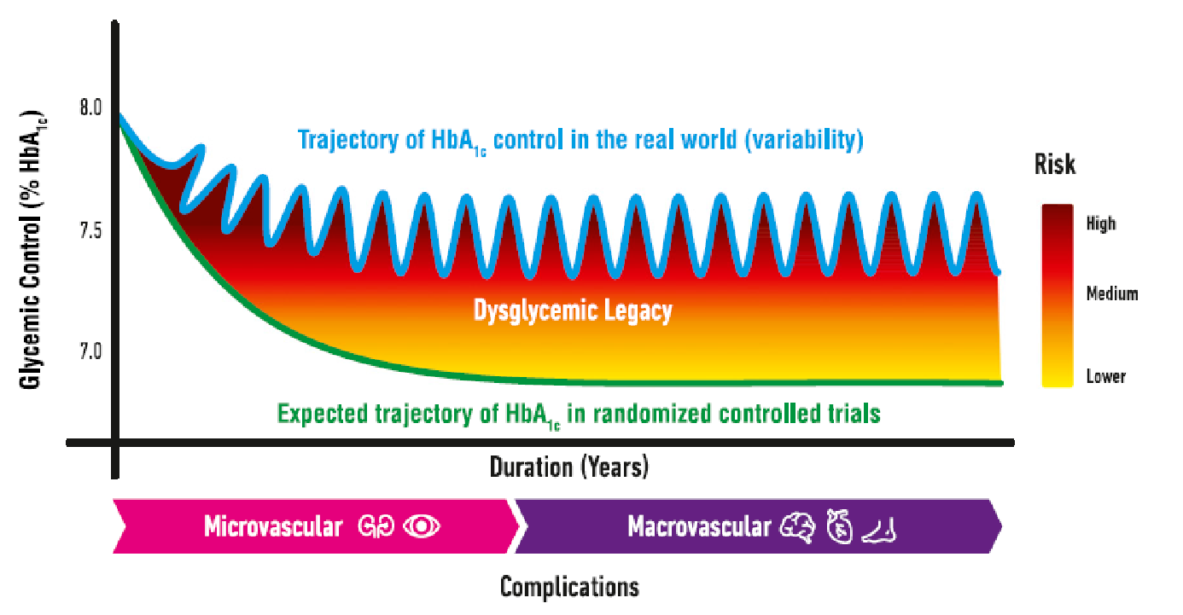
Dysglycemic Legacy
Diabetes Care 2019;42:349–351

Slide 17
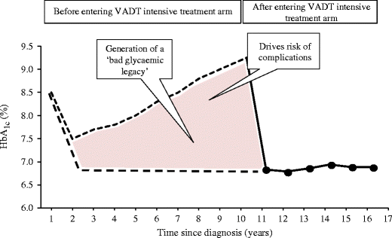
“Glycemic Memory”- Treating all our patients and not only new onset diabetics
Cristina Bianchi, Stefano Del Prato Metabolic Memory and Individual Treatment Aims in Type 2 Diabetes – Outcome-Lessons Learned from Large Clinical Trials Published online 2011 Nov 10. doi: 10.1900/RDS.2011.8.432

Slide 18
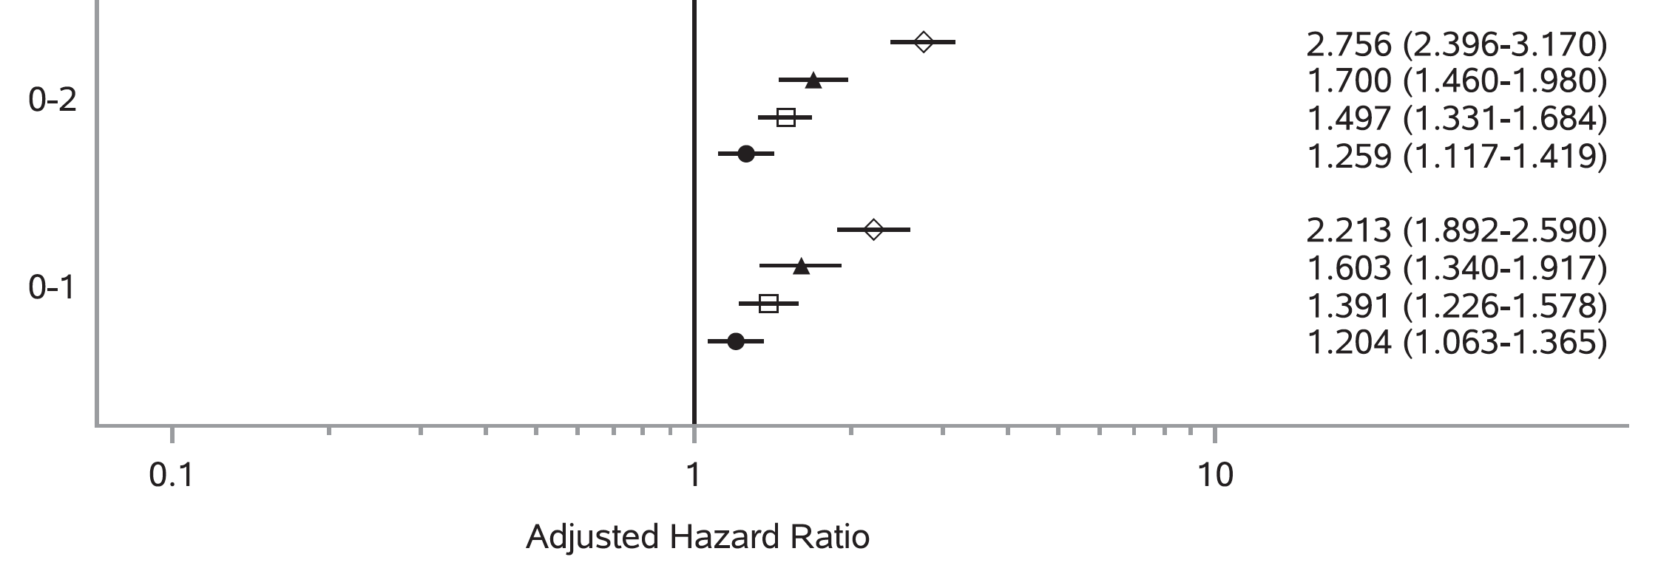
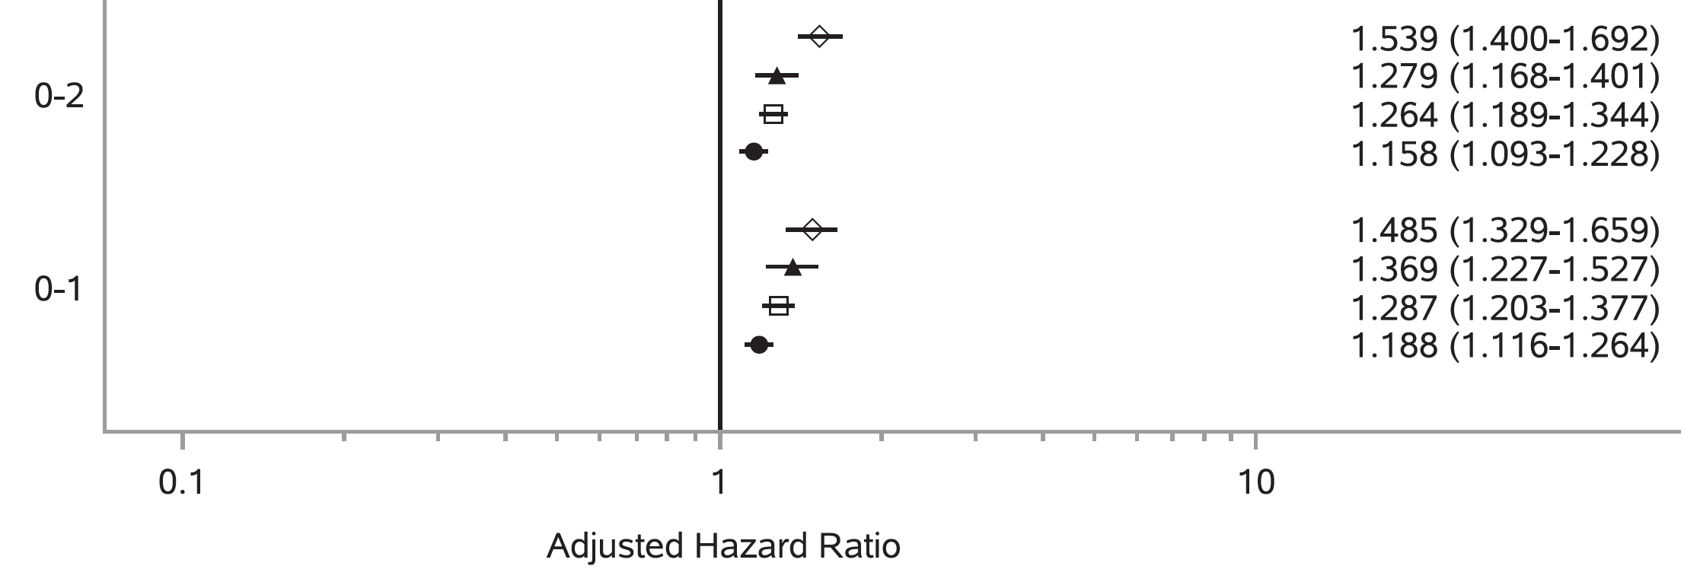
10-yr Risk of Complication for Early HbA1c >6.5%
34,737 managed care newly diagnosed T2DM patients; 10 years of survival (average follow-up 13.0 years)
Microvascular
events
Macrovascular
events
HRs adjusted for year of diagnosis, age at diagnosis, sex, race/ethnicity, BMI, systolic and diastolic blood pressure, total cholesterol, HDL cholesterol, smoking status, HbA1c after each early exposure period, and comorbidity.
Laiteerapong N et al Diabetes Care August 13, 2018, doi: 10.2337/dc17-1144. [Epub ahead of print]

Slide 19
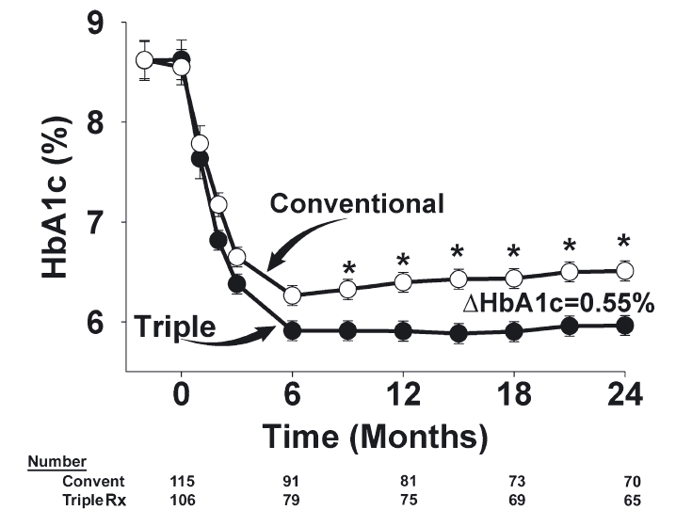
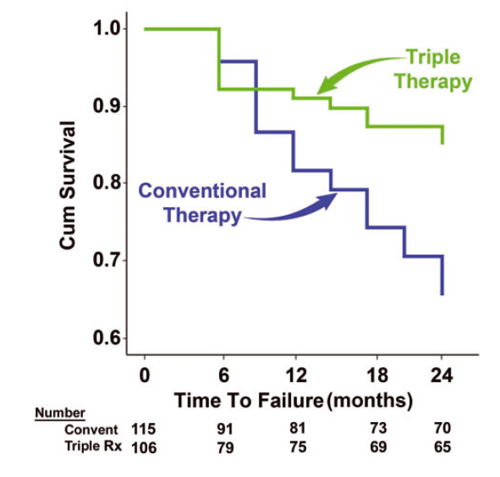
Pathophysiology-Driven Initial
Combination Therapy
Triple therapy: metformin+pioglitazone+exenatide
Conventional therapy: metformin followed by sequential addition of sulfonylurea and glargine insulin
Time to treatment failure (HbA1c >6.5%)
p<0.001
Abdul-Ghani MA et al Diabetes Obes Metab 2015;17:268–275

Slide 20
SIMPLE Guidelines
Lifestyle Modification, Team-Work, Patient Empowerment and Shared Decision Making Should Always be the Basis for Treatment
HbA1c not at target/co-morbidities consider metformin+ SGLT2i /GLP1 RA
Initiation of life-style intervention and Metformin
HbA1c>9.0% or symptomatic hyperglycemia consider (short term) Basal Insulin
First and Second line therapy for all patients:
Metformin
HF/CKD/ eASCVD
High Risk for or eASCVD
SGLT2i
GLP1-RA
Obesity
Every 3 months Reevaluation and Treatment Intensification when Appropriate!
Ofri Mosenzon , Stefano Del Prato , Meir Schechter , Lawrence A Leiter Antonio Ceriello , Ralph A DeFronzo , Itamar Raz , From glucose lowering agents to disease/diabetes modifying drugs: a "SIMPLE" approach for the treatment of type 2 diabetes. Cardiovascular Diabetology 2021; 20:91.

Slide 21
Real World Data

Slide 22
Response
% From 283 Responses
Response
% From 478
Responses
For how long you have been using CuraLin?
1 year
average
18 months
average
Do you feel safe using CuraLin?
Yes
98.2%
Yes
97.5%
Have you ever had a hypoglycemic event that you attribute to your CuraLin usage?
No
84.5%
No
83.5%
Have you experienced any negative side-effects that you or your doctor attribute to CuraLin?
No
94.3%
No
94.4%
Have you experienced a reduction in your HbA1c numbers that you attribute to CuraLine?
No
85.9%
No
81.6%
How satisfied are you with CuraLin?
Satisfied
Dissatisfies
Neither
90.5%
2%
7.5%
Satisfied
Dissatisfies
Neither
86%
2.7%
11.3%
Were any of these hypoglycemic events severe enough to require assistance from a 3rd party?
No
From 44 Responses
90.9%
No
From 79 Responses
96.2%
Where any of these side effects severe enough to cause hospitalization?
No
From 16 Responses
87.5%
No
From 27 Responses
100%

Slide 23
Response
% From 283 Responses
Response
% From 478
Responses
Specifically referring to the CuraLin supplement, not CuraLife as a company, how satisfied are you overall with CuraLin, considering effectiveness, safety, side-effects, and overall experience?
Satisfied
Dissatisfies
Neither
89.4%
2.5%
8.1%
Satisfied
Dissatisfies
Neither
87.2%
1.5%
11.3%
Have you been able to reduce your diabetes medications as a result of your CuraLin usage?
Yes
No
Maybe
64.7%
21.6%
13.8%
Yes
No
Maybe
59.4%
22.6%
18%
Would you recommend CuraLin to another diabetic?
Yes
No
Maybe
89.8%
1.4%
8.8%
Yes
No
Maybe
86.8%
2.3%
10.9%

Slide 24
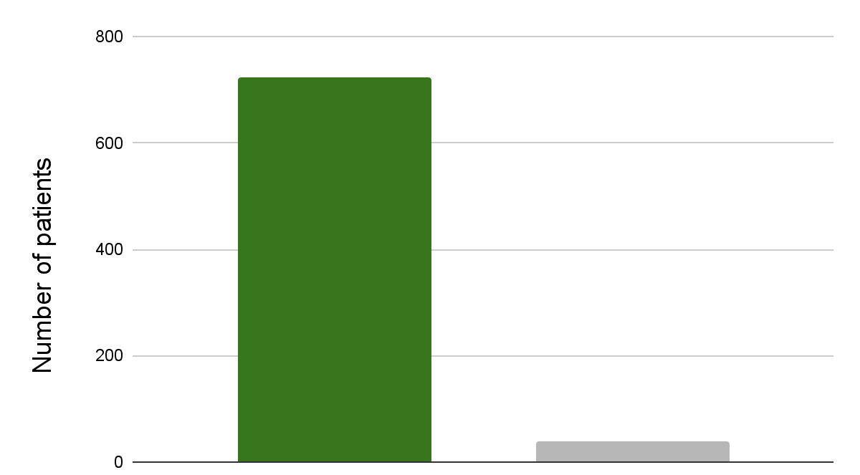
Have you experienced any negative side-effects that you or your doctor attribute to CuraLin?
No Side Effects
Side Effects
722
39

Slide 25
Out Of The 39 People That Reported Side Effects These Are The Side Effects That Were Reported
Side Effect | Cumulative number of reports
Hypoglycemia | 3
Upset Stomach | 3
Skin Rash | 0
Itchy Skin | 4
Weight gain | 6
Tiredness | 2
Dizziness | 1
Bloating | 3
Diarrhea | 5
Nausea | 1
Glucose levels went high | 1
Side Effect | Cumulative number of reports
Sugar going sky high | 1
Increased creatinine level | 1
Indigestion | 1
Lower sex drive | 1
Reflux | 1
Opens my bowl | 1
Had none of the above | 1
Acid reflux | 1
Weight loss | 1
Low Iron | 1
Pancreas | 1

Slide 26
Side Effect
The only common complaint about CuraLin is that in the beginning it might causes some stomach ache.
This is due to the natural ingredients that go into one’s body, and since people are not used to such ingredients in their everyday life, the body needs some time to get used to the ingredients and the feeling goes away within a few days.

Slide 27
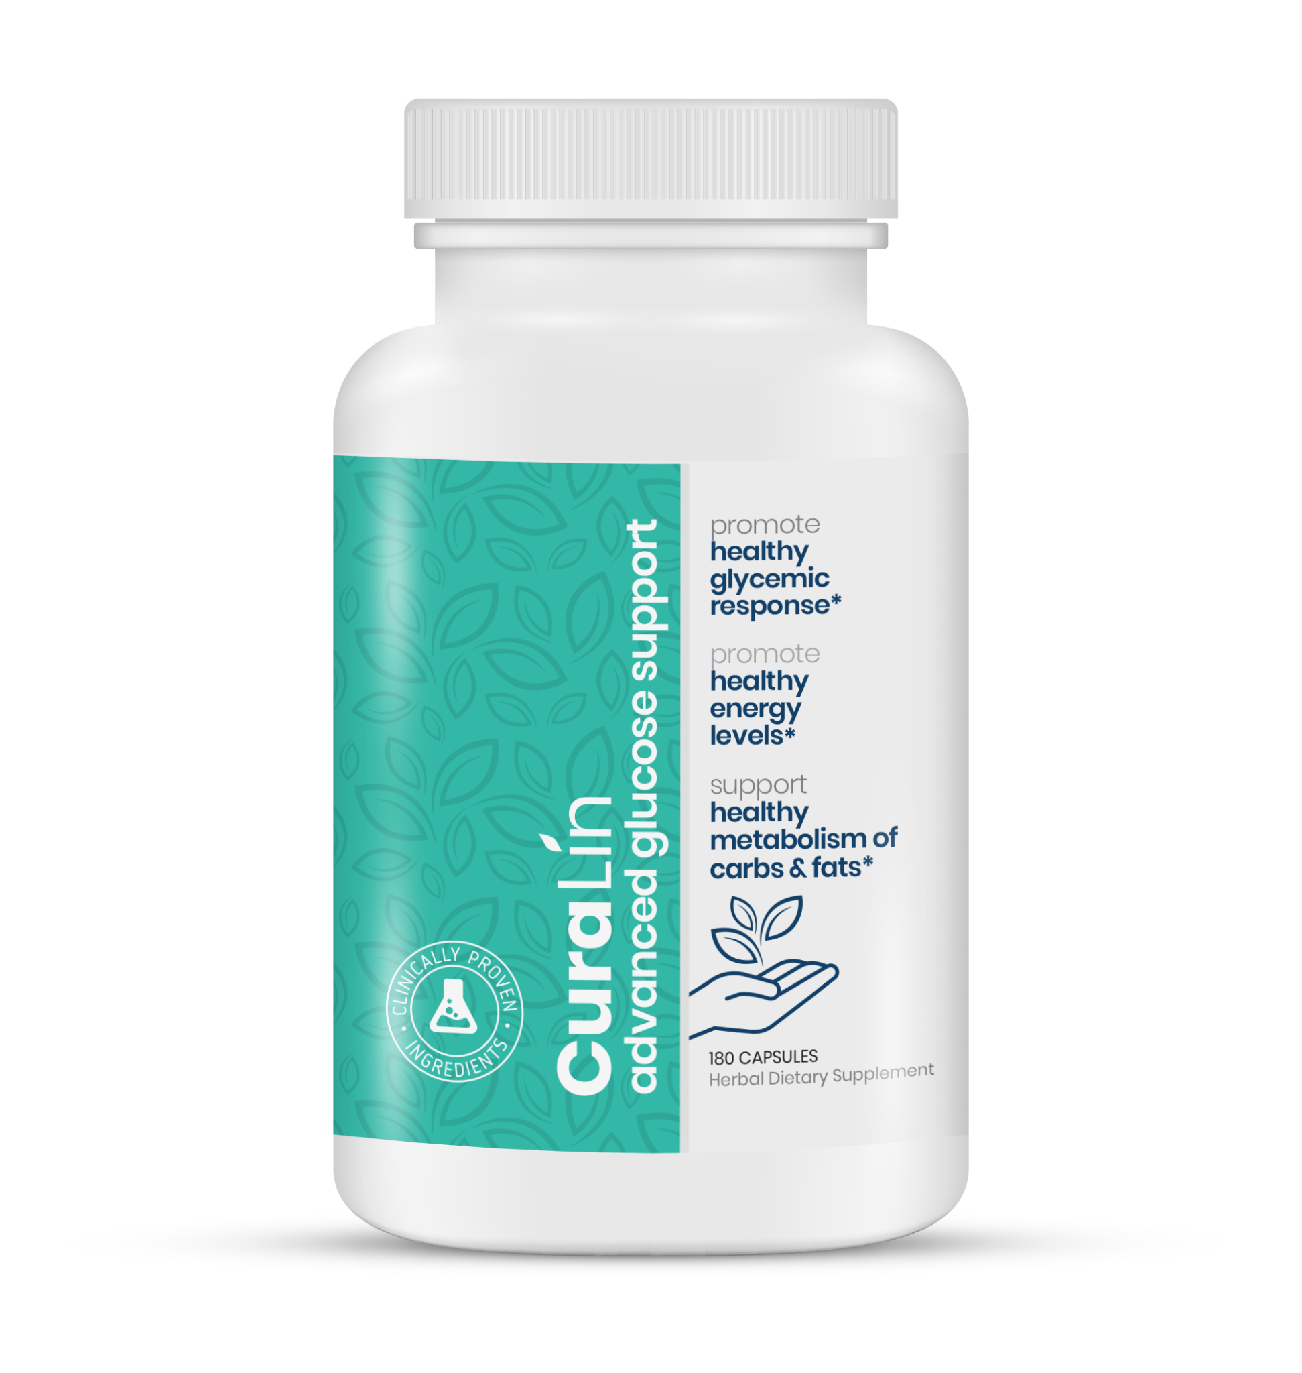
Cura- 01

Slide 28
Study Background
Name of Active Ingredients: The active components include: Momordica Charantia, Trigonella Foenum Graecum, Swertia Chirata, Emblica Officinalis, Gymnema Sylvestre, Curcuma Longa, Picrorhiza Kurroa, Eugenia Jambolana and Cinnamomum Zeylanicum.

Slide 29
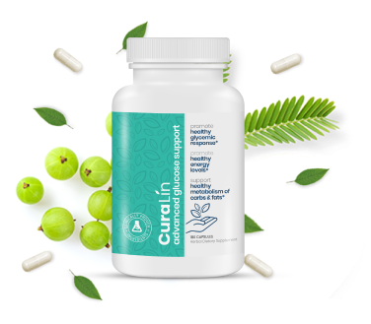
Study Background
Name of Investigational Product: Curalin
Phase of Clinical Development: II
Number of Patients Planned: 120 evaluable patients in total (60 per arm), with a sample size reassessment
Study Population: Adult patients with type II diabetes mellitus

Slide 30
Inclusion Criteria
Patients may be included in the study if they meet all of the following criteria:
Written informed consent is obtained.
T2D mellitus (18-85 years of age)
HbA1c 7.5% - 10%
BMI>25
Stable body weight (±10%)
Treated with anti-diabetic medications except Insulin.

Slide 31
General Design and Study Schema
Study Drug Dose; Curalin capsules- 2 capsules, 3 times a day after meals.
Placebo: matching placebo capsules, 2 capsules, 3 times a day after meals
Method of Blinding and Randomization: Randomization will allocate patients to Curalin or placebo in a 1:1 ratio.
Duration of Participation: Screening: up to 2 weeks, Placebo-controlled treatment period: 3 months, Open label treatment period: 3 months.

Slide 32
General Design and Study Schema
Open label treatment Period:
At the end of the dowable blind study participants will be invited to participate in a 3-month open label extension;
During the open label extension, all patients will receive Curalin, irrespective of the arm they were in during the double-blind placebo-controlled period.

Slide 33
General Design and Study Schema

Slide 34
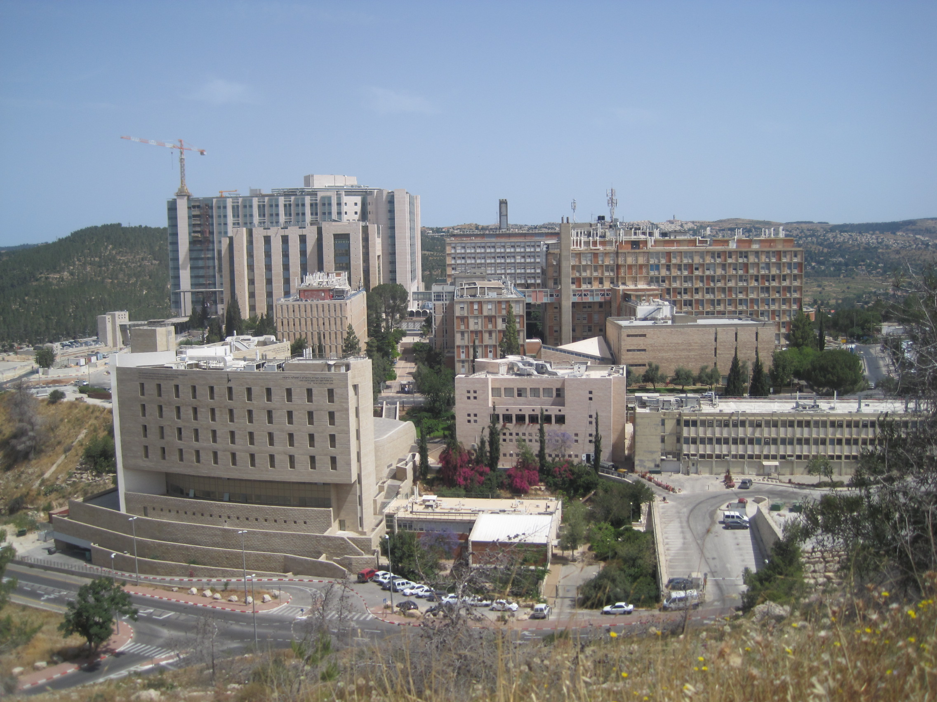
Thank You

