Slide 1
Using Specialized Panels to Identify Food Sensitivities Across Culturally Diverse Diets
Presented by Dr. Chris D. Meletis, ND

Slide 2

Today’s Presenter
Dr. Chris D. Meletis, ND
Dr. Chris Meletis is an educator, international author and lecturer. His personal mission is “Changing America’s Health One Person at a Time.” Dr. Meletis has authored 16 books and over 200 national scientific articles in journals including Natural Health, Alternative and Complementary Therapies, Townsend Letter for Doctors and Patients, Life Extension and Natural Pharmacy.
Dr. Meletis served as Dean of Naturopathic Medicine and Chief Medical Officer for 7 years for the National College of Naturopathic Medicine (now the National University of Natural Medicine). He was awarded the 2003 Physician of the Year by the American Association of Naturopathic Physicians. He has a deep passion for helping the underprivileged and spearheaded the creation of 16 free natural medicine healthcare clinics in the Portland metropolitan area of Oregon.
Dr. Meletis serves as a consultant to US BioTek on the clinical application of its laboratory tests. The views expressed are his own.

Slide 3
The written and spoken materials in this webinar are subject to Copyright. Materials may not be copied or reproduced without express written authorization of the speaker.
This audio recording may not be published elsewhere without express written authorization of US BioTek Laboratories. Views expressed by the speaker during the recording may not always reflect the views of US BioTek Laboratories and are the opinion of the speaker.
For questions, please contact Client Services at US BioTek Laboratories.
© 2020 US BioTek Laboratories, LLC. All Rights Reserved.

Slide 4
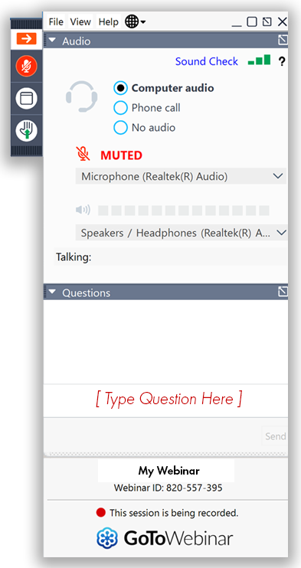
To Ask a Question:
  Participants are joined in listen-only mode
  Type your question in the Questions pane in the GoToWebinar control panel (usually on the right side of your screen) and press send
  You can type your question in at any time during the presentation
  Questions will be queued and answered at the end of the presentation
© 2020 US BioTek Laboratories, LLC. All Rights Reserved.

Slide 5


Topics of the Day
Selecting the appropriate panel can better uncover sensitivities and accelerate your patients’ paths to better health.
Compare and contrast clinical insights on the Asian, Japanese, Hispanic Influenced (Mexican), and Vegetarian panels.
When to order a 96, 144, or 208 food panel.
Discuss inadvertently sabotaging wellness protocols with an immunologically reactive food, spice, and/or botanical antigen.
© 2020 US BioTek Laboratories, LLC. All Rights Reserved.
© 2020 US BioTek Laboratories, LLC. All Rights Reserved.

Slide 6




A Country of Immigrants with Diverse Eating Habits
© 2020 US BioTek Laboratories, LLC. All Rights Reserved.

Slide 7

© 2020 US BioTek Laboratories, LLC. All Rights Reserved.

Slide 8
© 2020 US BioTek Laboratories, LLC. All Rights Reserved.

Slide 9


Slide 10
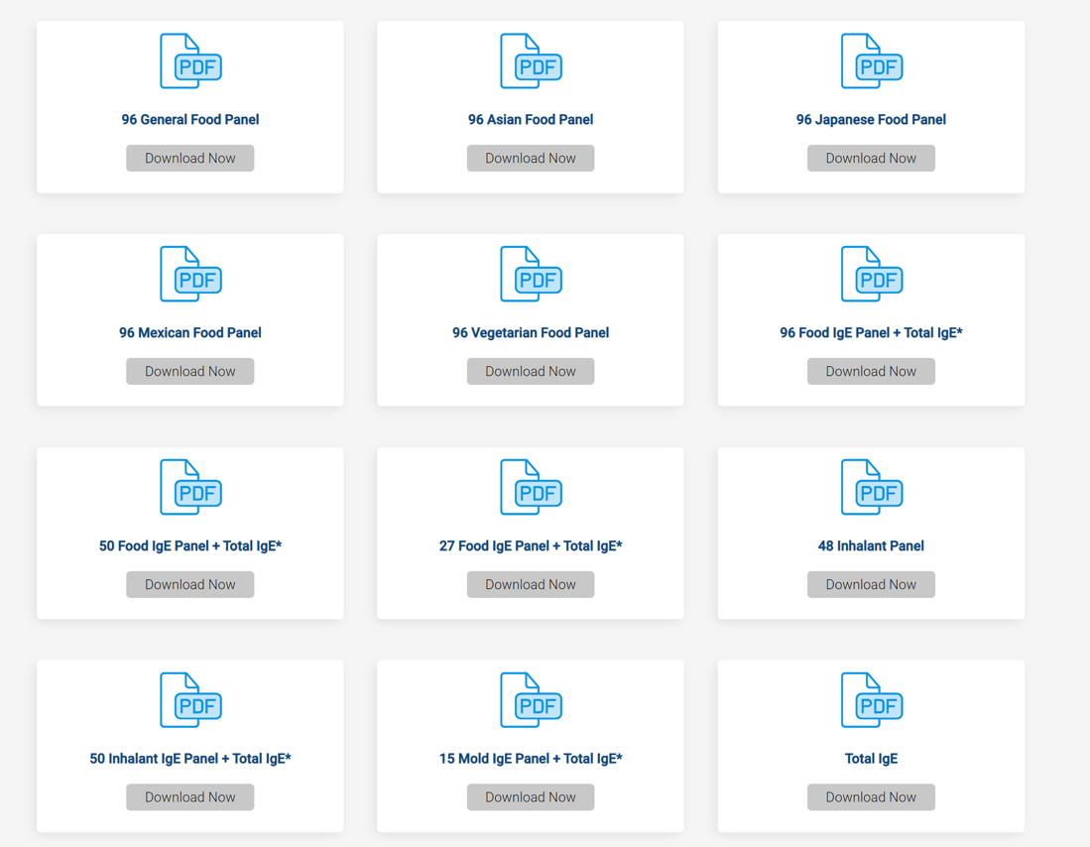

Food Panel Testing Menu

Slide 11

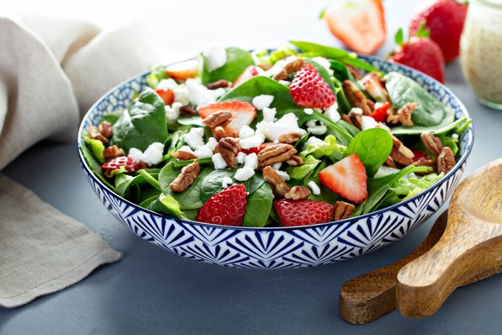


51 Year Old Female Presents
Presents to clinic with goal to reduce bloating, burping, body aches and season allergies
Reports eating a Standard American Diet
Discovered also Diabetic, Hashimoto’s Thyroiditis
Upon visiting about diet discovered patient is “Carbivore” that identifies as Vegetarian
Which Panel do I pick for her on a limited budget?

Slide 12
© 2020 US BioTek Laboratories, LLC. All Rights Reserved.

Slide 13
© 2020 US BioTek Laboratories, LLC. All Rights Reserved.

Slide 14
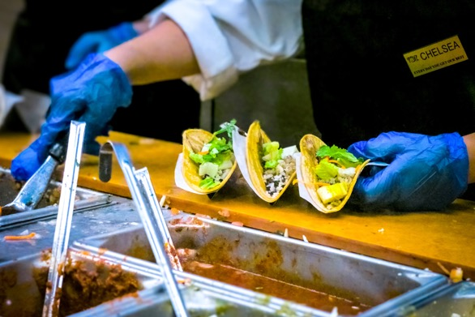
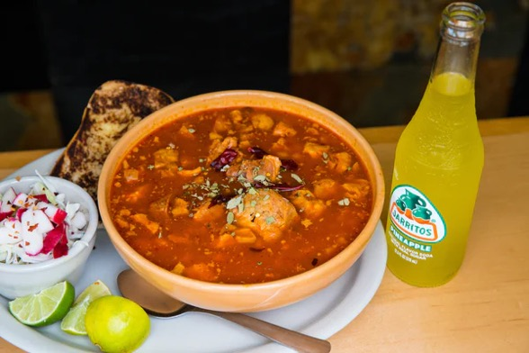
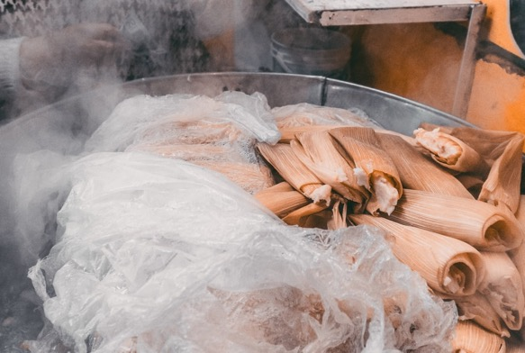
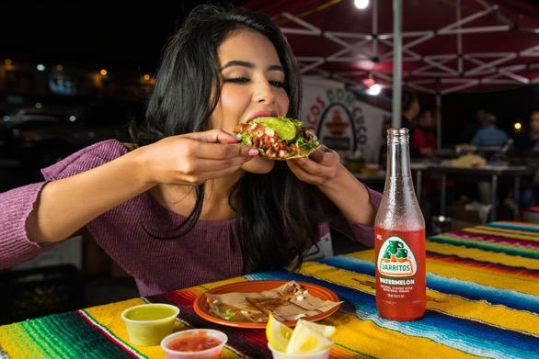
40 Year Old Female Executive
Wants to Lose Weight
Migraine History
High Stress Job –Leaves Home at 5:30 AM
Partner introduced her to Panamanian Diet
© 2020 US BioTek Laboratories, LLC. All Rights Reserved.

Slide 16
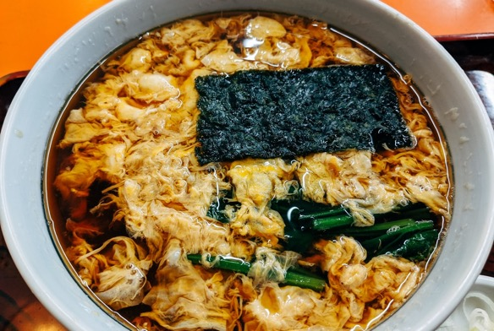

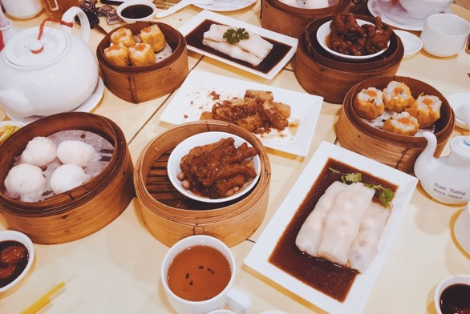

30 Year Old Marketing Guru
General Wellness Goals
Inflammation/GI Harmony
Immune Optimization
Partner is Korean—Eats Soy, Adzuki & Mung Beans
What Panel to Pick—Japanese or Asian?
© 2020 US BioTek Laboratories, LLC. All Rights Reserved.

Slide 18
© 2020 US BioTek Laboratories, LLC. All Rights Reserved.

Slide 19

Helping Our Patients in the Obstacle Course of Life
It’s hard to avoid what you can’t see or aren’t AWARE of.

Slide 20

96 General vs. 96 Cultural –Food Panel
144 Food Panel
208 Food Panel

Slide 21
Front. Immunol., 2014(10):1-17.

Slide 22
© 2020 US BioTek Laboratories, LLC. All Rights Reserved.

Slide 23
© 2020 US BioTek Laboratories, LLC. All Rights Reserved.

Slide 24
IgG, IgA and IgG4
These are general guidelines for interpreting food sensitivity (IgA, IgG and IgG4).
IgG is the most abundant antibody in the patient's blood When it comes to most patients the following interpretative guide is what I apply to guide patient dietary changes. I allow patients to eat scores of "0" freely, if it is close to a "1" score
IgG "1" scores I allow patients to consume once every 4 days. And 2, 3 and 4's I have the patients avoid for a minimum of 3 to 6 months while working on building up GI health with such things as l-Glutamine, Collagen, Probiotics, and N-Acetyl-Glucosamine (this one contains crustacea so be aware of shrimp/shellfish/etc. reactions). A broad plant based digestive enzyme with DPP IV to address protein antigen burden.
IgA reactions are scored even more strictly. I have my patients avoid 0.5 scores (that is even <1.0); this immunoglobulin is mucous membrane related and "Should Not" be highly reactive. Thus any score above 0.5 I have them avoid these foods.
IgG4 reactions are by far the most complicated. Interpretation of these scores must take into account the provider's history taking of the patient relative to health concerns, family history, and diagnosed conditions. We know inherently for many patients IgG4 is a BLOCKING ANTIBODY, and can lessen IgE or other IgG reactions.
YET, and this a BIG YET-- IgG4 scores are elevated in certain conditions such as Eosinophilic Esophagitis (that can masquerade as GERD/Acid Reflux); also elevated in patients with IBS and also IBD (autoimmune Crohn's and Ulcerative colitis); and also are individuals experiencing AUTISM. In these cases, elevated IgG4 can be pointing directly to IgG4 elevation being contributory to the symptoms and thus I have the patient avoid them.
© 2020 US BioTek Laboratories, LLC. All Rights Reserved.

Slide 25



3 Types of Food Sensitivity Reactions
"Fixed" reactions can most simply be considered genetic, imagining if a mother or father has reactivity to a substance, there is a likelihood that one or more of their children will present with common overlaps in their scores, with the potential that the child's unique genetics may present completely individualized. Imaging a "True Allergy being an IgE" score why does a young child presents with a potentially life-threatening anaphylactic reaction? It is the unfortunate luck of the draw if there was not a precipitating factor.
Fixed Reactions
"Earned" reactivity is when a food has been over consumed. There will be other foods equally consumed often in their diet yet there is not a commensurately elevated score. Yet, if a genetic susceptibility immunologically or cross-reactivity is present, the "Over Consumption" of such food will lead to an "Earned" reaction, which is a reaction that is amplified based on the pattern of eating and propensity to react to that given food.
Earned Reactions
“Cross-Reactions” As can be seen, if a person has a birch reaction they can react to nuts, pit fruits and much more. Likewise, if a person has a latex reaction they can react to the many foods including bananas, avocados, etc. In turn, if a person has a dust mite allergy, a reaction to shrimp or other crustacea can present.
Cross Reactions
Important to look at reactivity from a functional medicine "whole body" and "complete immune reactivity" or put another way, the proverbial straw that broke the camels back which is a composite of the overall total burden.
© 2020 US BioTek Laboratories, LLC. All Rights Reserved.

Slide 26




Re-Testing Concept
Identify if Leaky Gut and Hyper-Reactivity has Been Diminished
Question Retest with Provocation (Re-Introduction of Reactive Foods)?
Differentiate between “Fixed” and “Earned” Reactions and “Cross-Reactions”
Reactive Foods Identified
Avoid / Lessen for 3-6 Months
Gut Repair Protocol
Retest
Before Retesting: IgG "1" scores I allow patients to consume once every 4 days. And 2, 3 and 4's I have the patients avoid for a minimum of 3 to 6 months while working on building up GI health with such things as l-Glutamine, Collagen, Probiotics, and N-Acetyl-Glucosamine (this one contains crustacea so be aware of shrimp/shellfish/etc. reactions). A broad plant based digestive enzyme with DPP IV to address protein antigen burden.
© 2020 US BioTek Laboratories, LLC. All Rights Reserved.

Slide 27


IgG – Delayed Reaction
3
2
Food Sensitivity
1
Little Scores
can become
BIG
Tuesday
72 hours
Wednesday
72 hours
Thursday
72 hours
3 Day Stacked Effect

Slide 28

On Demand Webinars

Slide 29

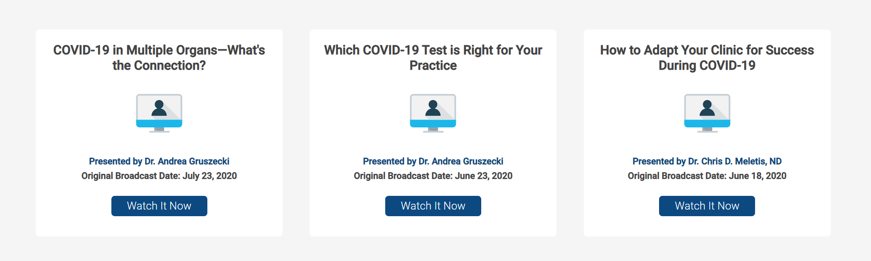
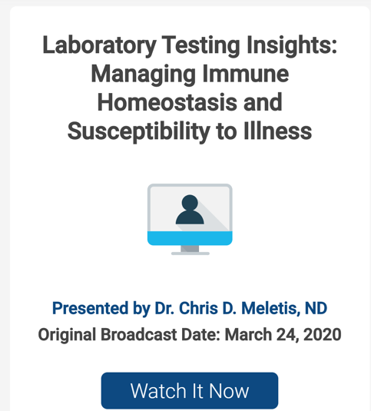
© 2020 US BioTek Laboratories, LLC. All Rights Reserved.

Slide 30

A Melting Pot of Humanity

Slide 31
Q&A
Questions? Contact us at info@usbiotek.com
Dr. Chris D. Meletis→NaturalMedMan@Hotmail.com
Questions? Contact us at info@usbiotek.com

Slide 32
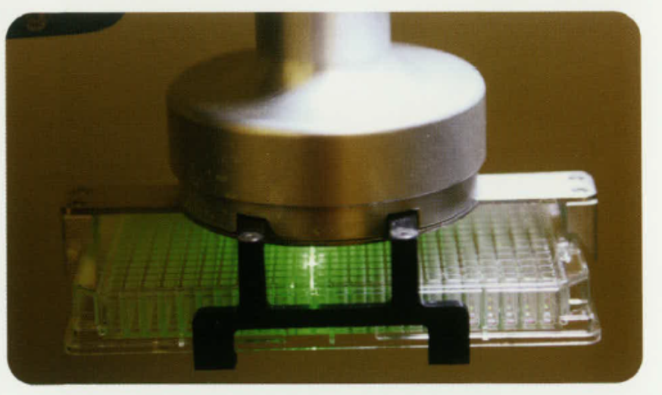

My Clinical Approach — “Testing Not Guessing”
Questions?
Dr. Chris D. Meletis→NaturalMedMan@Hotmail.com

